Slide 1


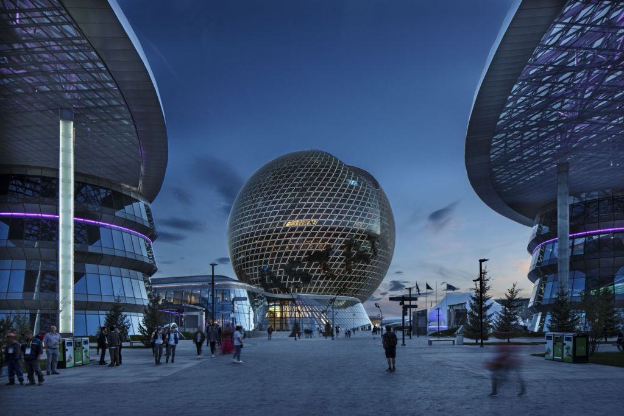
TELEGRAM BOT FOR PERSONAL DIET PLANNING
Zhigerbayev Yerkebulan
SE-2001

Slide 2
AGENDA
Introduction
Methodology
Conclusion
Progress
References

Slide 3
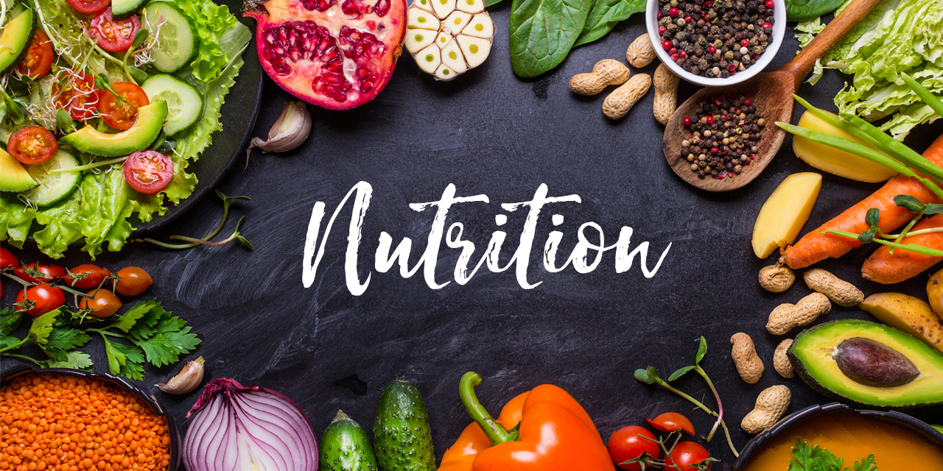
INTRODUCTION
PROJECT IDEA
The main objective of my project was dedicated to create a bot for telegram channel that will compose an individual diet and subtract how much protein, carbohydrates, fats, fiber, vitamins, and water is needed for each person, considering his / her characteristics, such as age, gender, weight, height and so on.

Slide 4
METHODOLOGY
Resourses
Data collection
https://builderbody.ru/pitanie-dlya-nabora-myshechnoj-massy/
Process analysis
Backend of Telegram bot is written on Python
https://mydiets.ru
The compiler is PyCharm 2020
https://habr.com/ru/post/442800/
Geek Code
GitHub

Slide 5
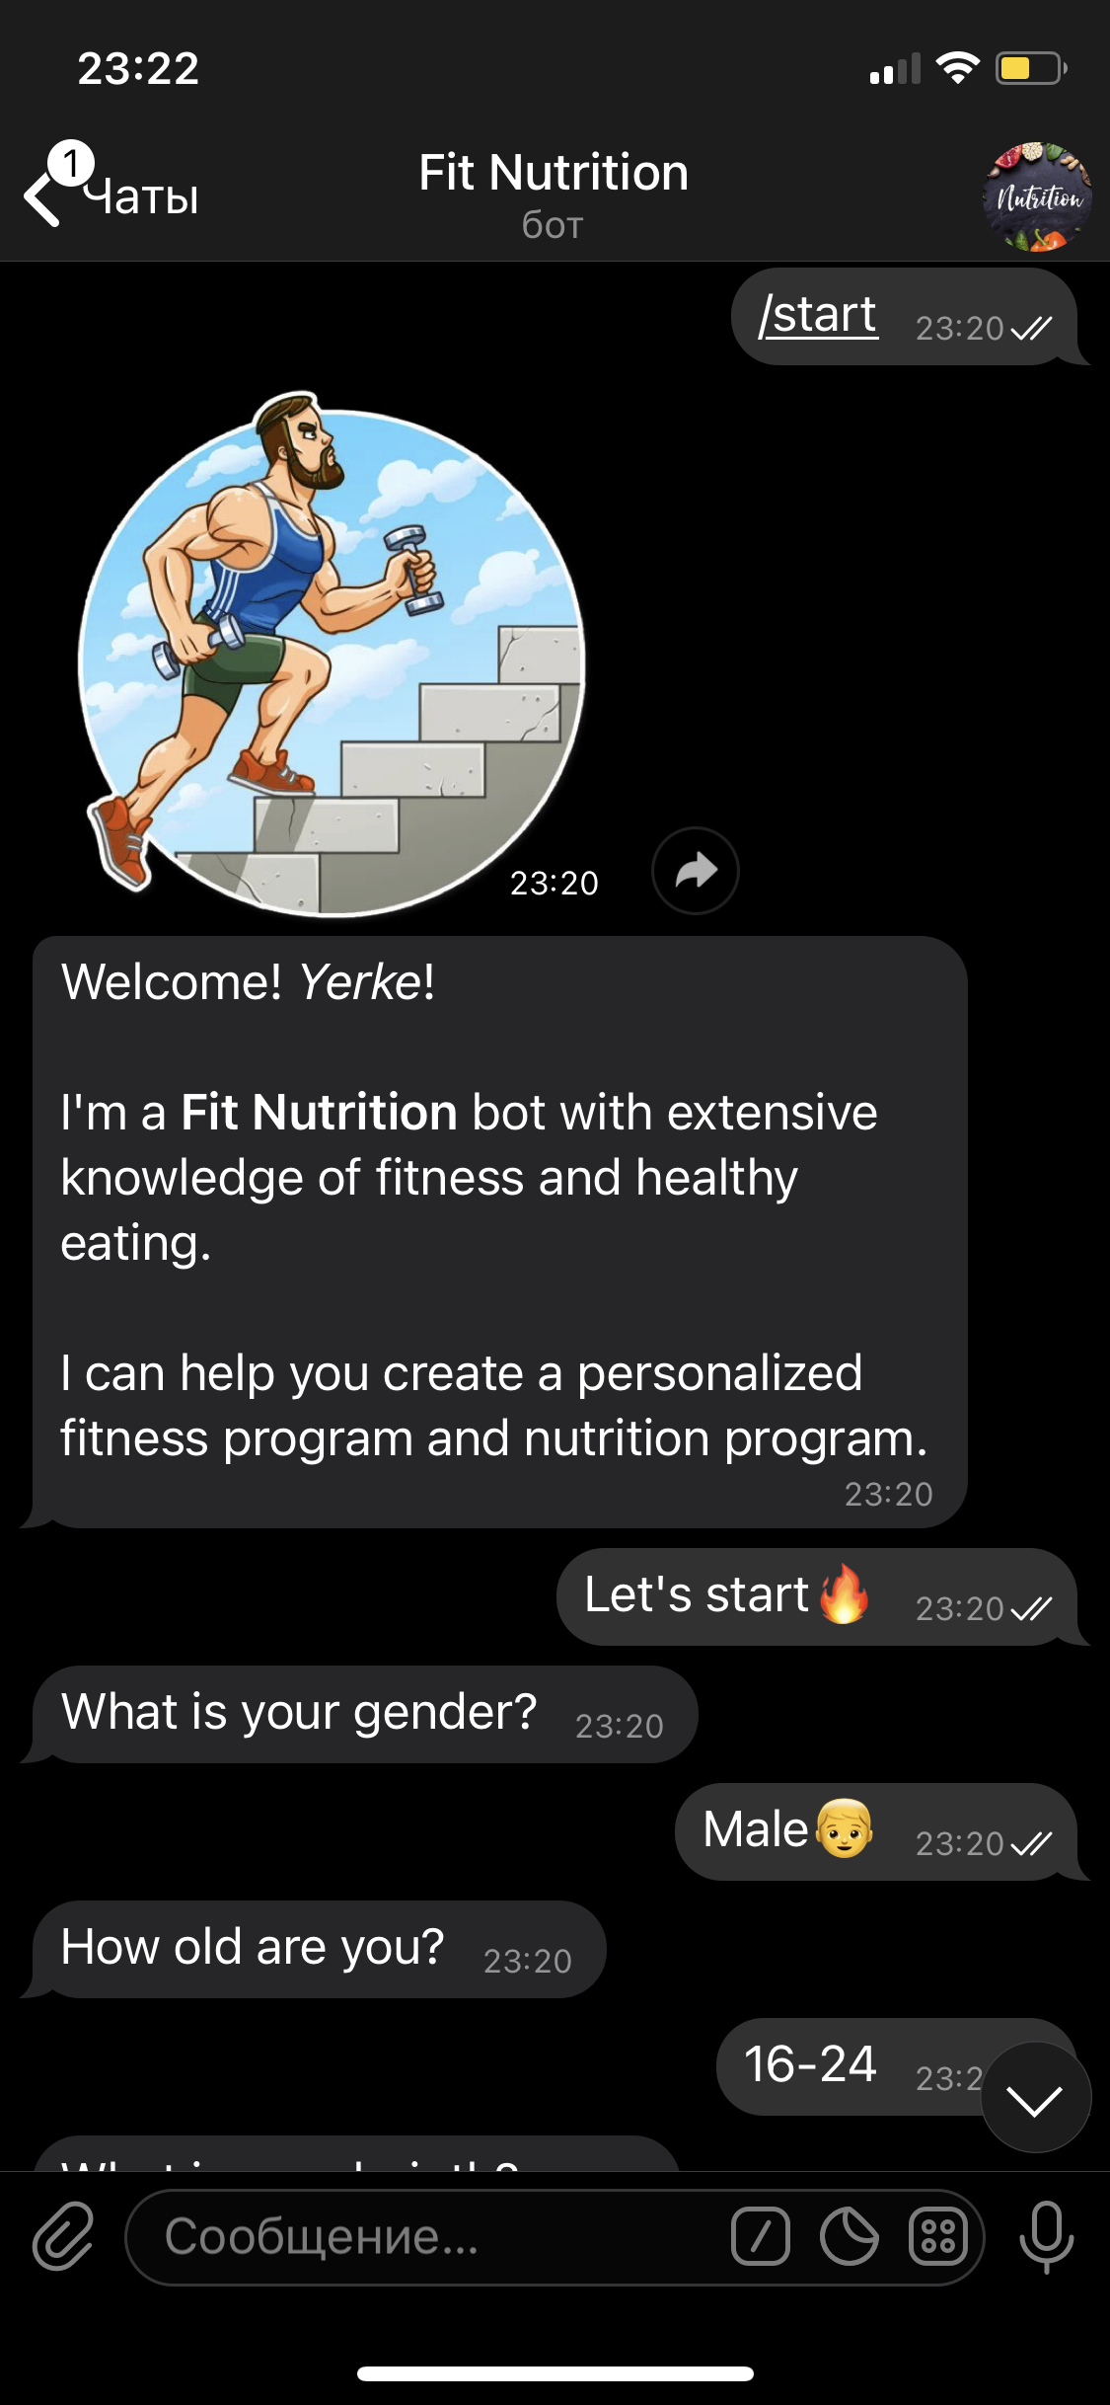
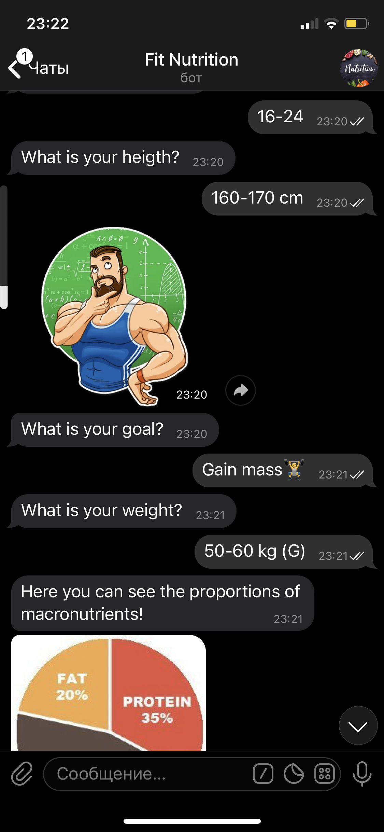
PROGRESS
During the educational practice I have created the Telegram bot “Fit Nutrition”.
The bot aims to collect data about the gender, age, weight, height, and goals of each client and calculate how many microelements are needed for healthy nutrition.

Slide 6
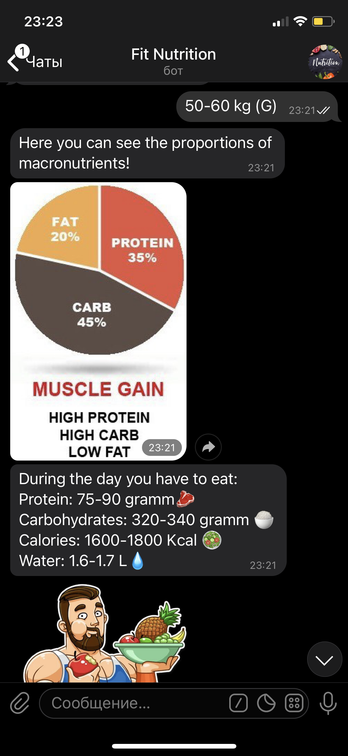
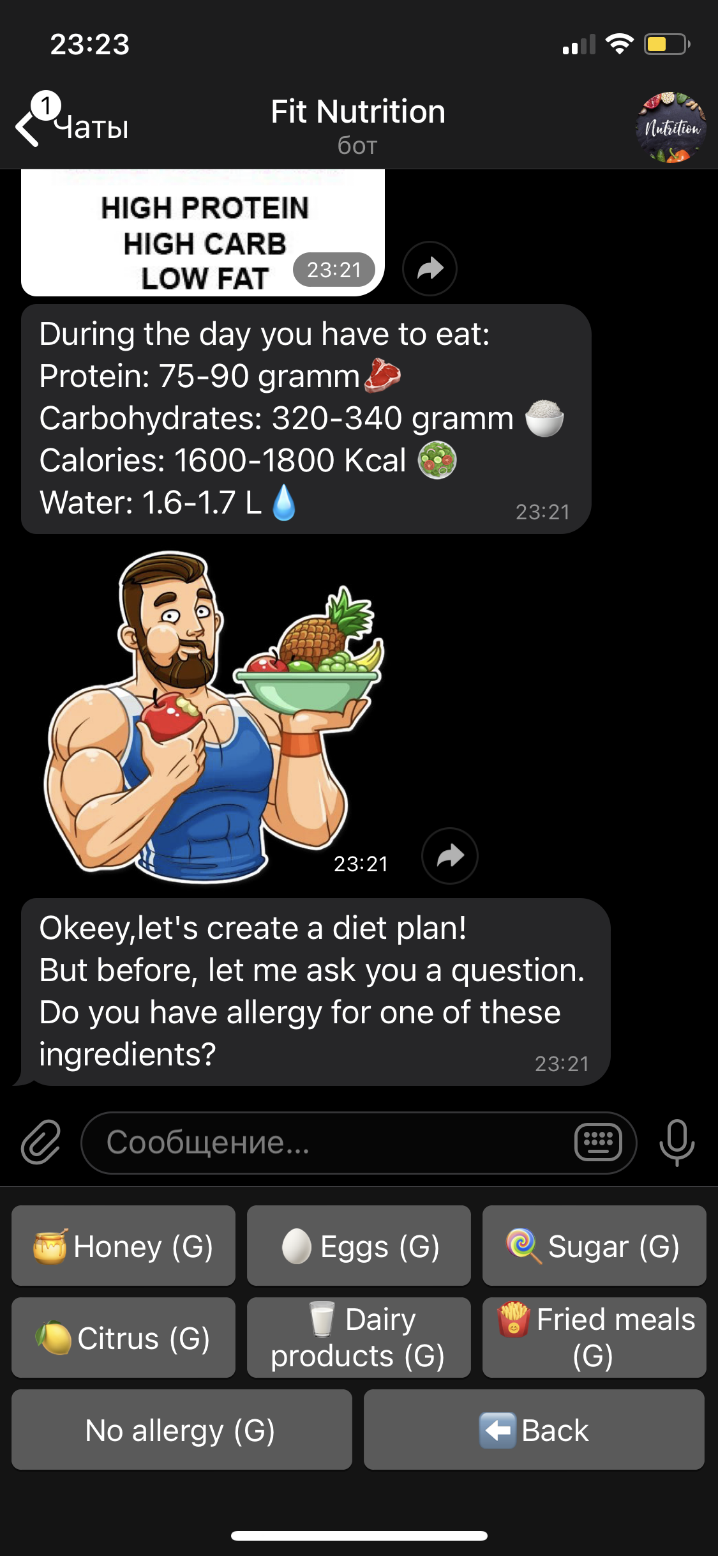
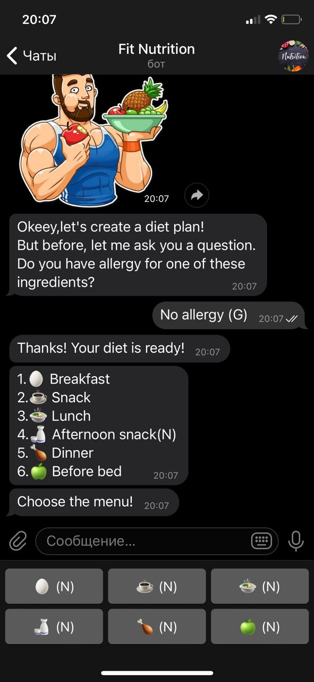
FINDINGS
PROGRESS
After the calculations of proportions, Bot asks does a user have an allergy to one of these given ingredients, then considering all characteristics Bot composes an individual diet plan.

Slide 7
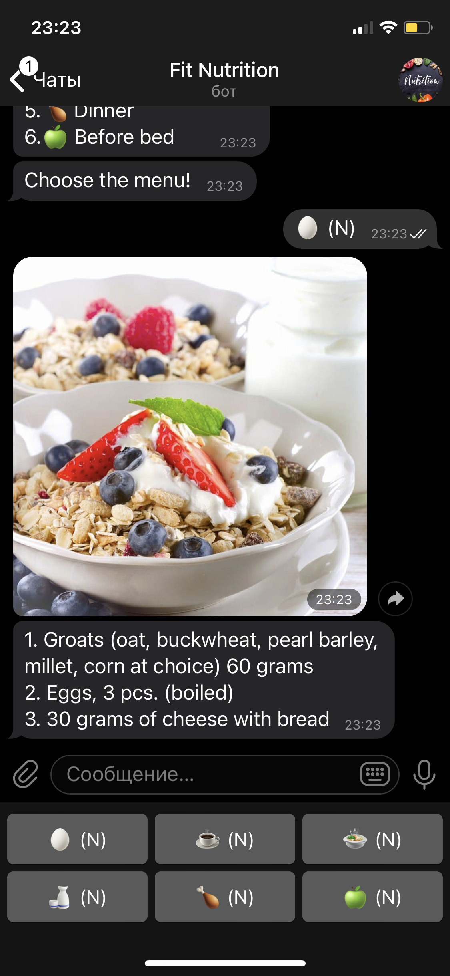
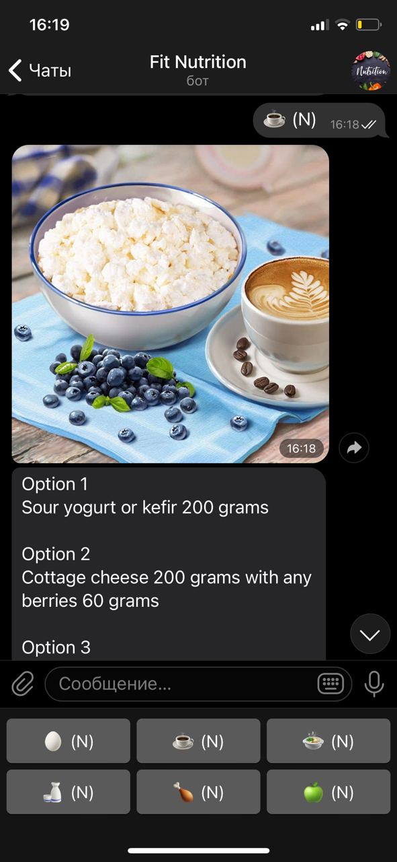
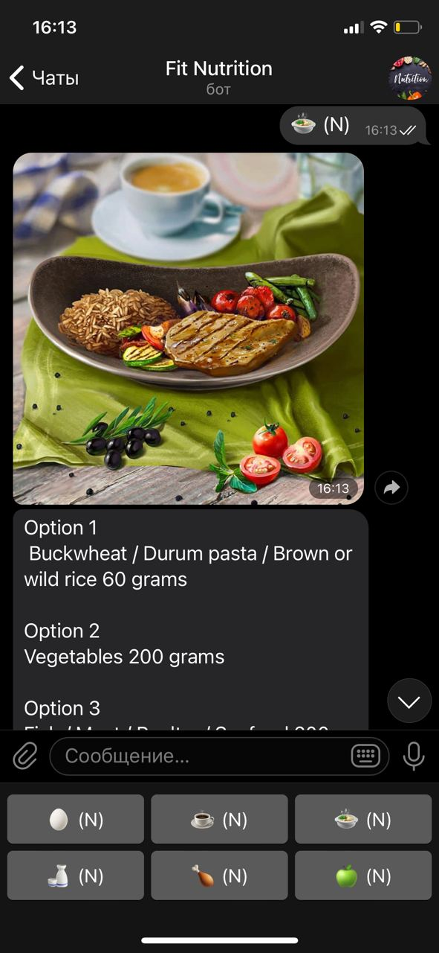
PROGRESS
Having learned all preferences, the bot will begin to compose your diet and offer you 5-6 meals depending on your goals

Slide 8
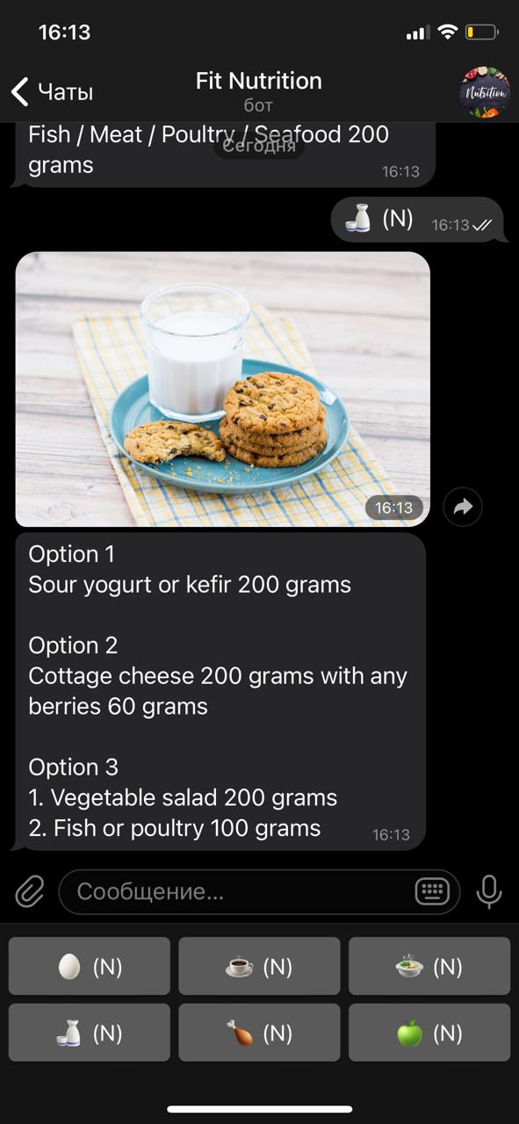
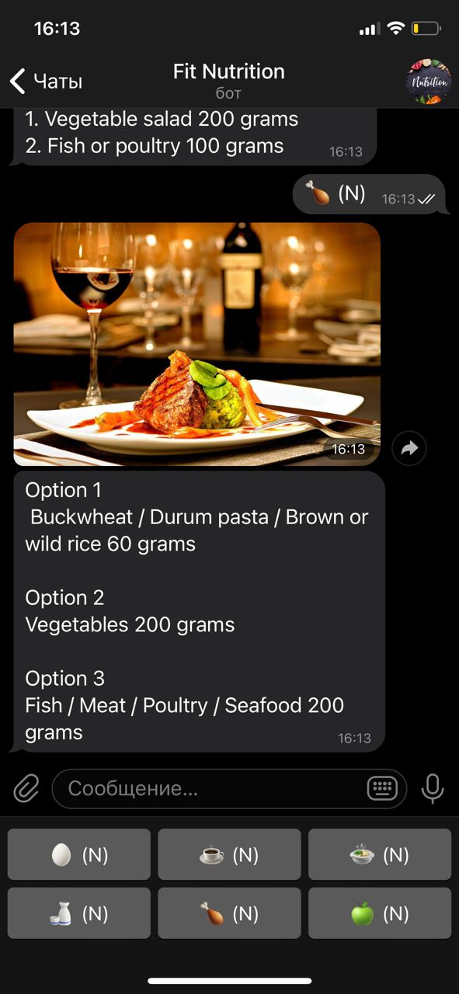
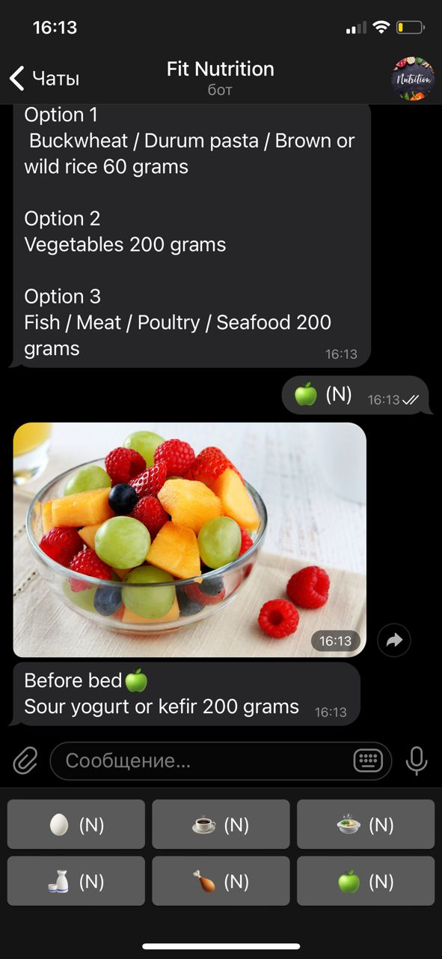
PROGRESS
Choosing a meal Bot will explain how much of a particular food you need to eat.

Slide 9
CONCLUSION
Considering the main factors of a healthy diet, investigations were done during the 2 weeks of the educational practice learning correct proportions and rules of microelements such as protein, carbohydrates, fat, and minerals needed to the balanced nutrition. The acquired knowledge was applied in the creation of a Telegram bot that made up the personalized diet plan depending on the goals and characteristics such as gender, age, weight, and height of each person.

Slide 10
REFERENCES
Nutrition for gaining muscle mass. (2020). Retrieved 3 July 2020, from https://builderbody.ru/pitanie-dlya-nabora-myshechnoj-massy/
My Diet-Rules of being healthy. (2020). Retrieved 5 April 2020, from https://mydiets.ru
Write a Telegram Bot in 30 minutes. (2020). Retrieved 18 january 2020, from https://habr.com/ru/post/442800/

